Slide 1

Welcome
Data Skills 1
Week 4: Percentages & Fractions

Slide 2
Today’s Lesson
Homework review
Week 3 recap
From decimals to percentages (and back)
The three components of a percentage problem
Fractions
Equivalent forms review
Using percentages in the retail sector

Slide 3

Homework review/week 3 recap

Slide 4
Homework review
Week 3 quiz
Kortext page 115 numbers 1-10. Answers page. 122
Notes:
Please go over any problem areas with students.

Slide 5
Week 3 recap
Say the following numbers.
Round to the nearest tenth:
345.67 67.81 976.89
Round to the nearest hundredth:
1056.777 2322.236 100.323
Notes:
Do this at whole class level to save time. Nominate students to say the correctly rounded decimal numbers.

Slide 6
From decimals to percentages (and back)

Slide 7
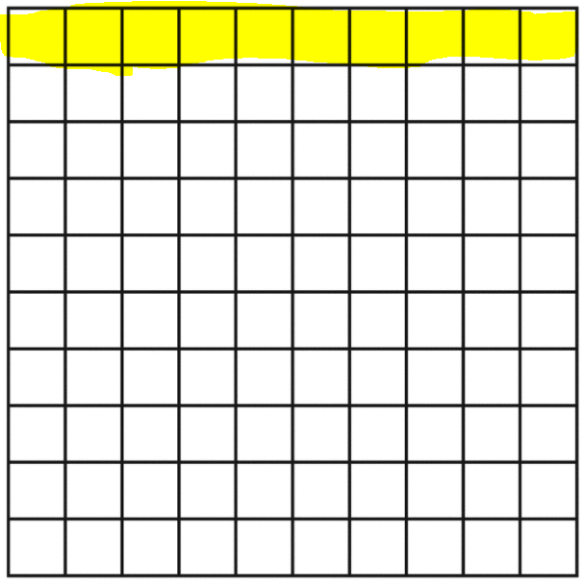
What is a percentage?
The expression “per cent” means “per hundred.”
A percentage is another way of describing part of a whole.
The box opposite contains 100 squares. The top row of ten is highlighted in yellow. Firstly, how could we read/write this as a decimal in words and as a number?
Answer: one tenth or 0.10

Slide 8
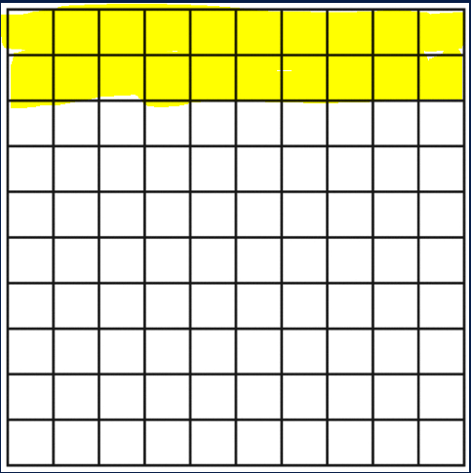
From decimals to percentages
We can also express the decimal number as a percentage. ‘One tenth’ is the same as ten out of a hundred which, as a number, is written as 10%.
This is the ‘percentage’ sign: %
Look at the box opposite. Now there are 20 boxes out of 100 highlighted in yellow. How could we express this as a percentage, a decimal number and in words?
Answer: 20% or 0.20 or two tenths
Calculation of decimal to percentage: 0.20 x 100 = 20%

Slide 9
From percentages to decimals
How do we find the decimal number if we start with a percentage?
Simply divide the percentage by 100, e.g.:
56% is 56/100
= 0.56

Slide 10
Practice
Express the following as either a decimal or percentage:
1. 52%
2. 38.5%
3. 0.14
4. 0.643
5. 0.05
0.52
0.385
14%
64.3%
5%

Slide 11
The three components of a percentage problem

Slide 12
Solving percentage problems
Percentages are a very common, if not the most common, way of presenting part of something, e.g. ‘tax bands', 'interest rates’ ‘trade markups’ and ‘discounts’ all use percentages.
We’re going to look at these examples in this module, but first, let’s look in more detail at how to work with percentages by understanding the three components of a percentage problem:
Calculating percentage ‘rate’
Calculating ‘portion’ or ‘part’
Calculating ‘base’ or ‘total’

Slide 13
Calculating the percentage ‘rate’
What is the ‘rate’, or percentage, of students with children in today’s class?
There are a total of ___ students in the class.
How many students have children? ___
The total is also known as the base.
The number of students with children is known as the portion or part.
RATE = PORTION / BASE x 100
Notes:
Please insert the actual numbers from YOUR class.

Slide 14
Practice
Find the percentage rate
1. If 20 cars were sold from a garage that had 50 cars, what percentage of cars were sold?
2. Ali gave correct answers to 23 out of 25 questions on a driving test. What percentage of the questions did he get correct?
20 (portion) / 50 (base) x 100 = 40%
23 (portion) / 25 (base) x 100 = 92%
Notes:
Make sure students are referring to the formula slide.

Slide 15
Calculating ‘portion’
Sometimes, we may already have the information for the percentage rate and the base or total, but we don’t have information about the portion or part. To find this we perform the following calculation:
PORTION = BASE x RATE
Remember to change the percentage into a decimal before multiplying.
Notes:
Again, use the actual figures from your class as an example.
Encourage students to use any method of calculation that they are familiar with, as long as it leads to the right answer!
Explain that the portion is the percentage rate expressed in ‘raw’ value.

Slide 16
Practice
Find portion or part
75% of students in a class of 40 passed the first test. How many students passed?
40 (base) x 0.75 (rate) = 30 students passed
2. An ice cream truck began its daily route with 95 litres of ice cream. The truck driver sold 78% of the ice cream. How many litres of ice cream were sold? Round to the nearest litre.
95 (base) x 0.78 (rate) = 74 litres of ice cream were sold
Notes:
Make sure students are referring to the formula slide.

Slide 17
Calculating ‘base’
If we know the rate and the portion, but not the base or total, the calculation is:
BASE = PORTION / RATE
Remember the rate must be calculated using the decimal value
Notes:
Include the figures for the question on numbers of students with children as an example.

Slide 18
Practice
Find base or total
Poker tournament rules state that 10% of players who pay the entry fee will finish winning some money. If 877 players win money, how many paid the entry fee?
877 (portion) / 0.1 (rate) = 8,770 players paid the entrance fee
Notes:
Make sure students are referring to the formula slide.

Slide 19
Summary of formulas
RATE = PORTION / BASE x 100
PORTION = BASE x RATE
BASE = PORTION / RATE

Slide 20
Further practice
Work in pairs, or threes, and find the answers to the following. For each problem, first identify what information you need to find (the rate, the portion, or the base).
1. 48% of 12 is ____
You need to find the portion. You have the percentage rate (48%) and the base (12), therefore you need to find the portion, so 0.48 x 12 = 5.76
2. 32% of _____ is 28
You need to find the base or total. You have the rate (32%) and the portion (28), therefore you need to find the base, so 28 / 0.32 = 87.5
Notes:
This might be difficult for some students as they first have to work out which piece of the percentage problem they need to find. Again, refer them to the formula slide.

Slide 21
Further practice (cont…)
3. Holly Hobbs purchased a magazine at Atlanta airport for $2.99. The tax on the purchase was $0.18. What was the tax rate at the airport? Round to the nearest percent.
You need to find the rate or percentage. You have the base or total ($2.99) and the portion ($0.18), therefore you need to find the percentage rate, so 0.18 / 2.99 x 100 = 6%
4. The Drammelonnie Department Store sold 30% of its shirts in stock. If the department store sold 267 shirts, how many shirts did the store have in stock.
You need to find the base or total. You have the percentage rate (30%) and the portion (267), therefore you need to find the base, so 267 / 0.3 = 890

Slide 22
Expressing ‘part of whole’ using fractions

Slide 23
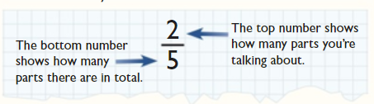
What are fractions?
So far, we’ve looked at decimals and percentages. These are both ways of describing part of a whole.
Another way of showing a part of a whole is to use fractions.
There are two parts to every fraction.
The top number is also known as the ‘numerator’ and the bottom number as the ‘denominator’.
https://library.cgpbooks.co.uk

Slide 24
Percentages to fractions
Any percentage can be written as a fraction whose denominator (the bottom number of a fraction) is 100. The fraction should be simplified if possible:
Example: Convert 59% into a fraction.
Written as a fraction.
Written as a decimal.

Slide 25




Decimals to fractions
When expressing decimals as fractions, place the non-zero digit(s) after the decimal point as the numerator (on top), and the ‘power of 10’ as the denominator (on the bottom), with the same number of zeros as there were decimal places.
Examples:
0.6 = $\frac{6}{10}$
0.08 = $\frac{8}{100}$
0.42 = $\frac{42}{100}$
0.003 = $\frac{3}{1000}$
Notes:
Also revise how to say these as decimal values, e.g. 0.6 as six tenths, etc.

Slide 26

Simplifying fractions
Where possible, fractions should be simplified (made smaller).
To simplify a fraction, divide both the top number (the numerator) and the bottom number (the denominator) by the same number. Keep going until it is no longer possible to divide either number without getting a decimal.
For example: $\frac{18}{100}=\frac{18}{100} ➗ 2=\frac{9}{50}$
9 can be divided by 3, but 50 cannot be divided by 3 so $\frac{9}{50}$ is the smallest fraction possible in this case.

Slide 27
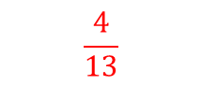

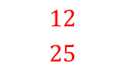
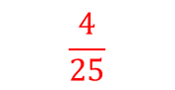
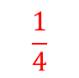
Practice
Write these fractions in their simplest form:
$\frac{25}{100}$
$\frac{16}{100}$
$\frac{12}{25}$
13 people took their driving test on the same day. Nine of them passed. What fraction didn’t pass?
25 divided by 25
100 divided by 25
$$\frac{1}{4}$$
16 divided by 4
100 divided by 4
$$\frac{4}{25}$$
$$\frac{12}{25}$$
$$\frac{4}{13}$$

Slide 28

Take a Break

Slide 29
Equivalent forms

Slide 30
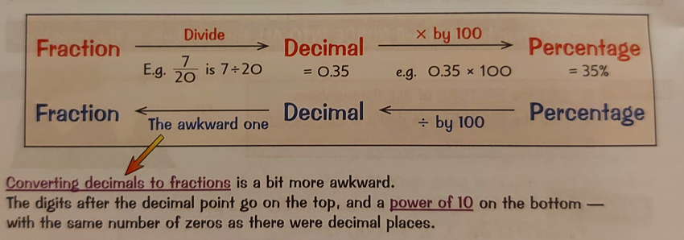
Equivalent forms
We have now looked at three different ways of representing part of a whole: decimals, percentages and fractions. The graphic below gives a summary of how to calculate from one to the others.

Slide 31
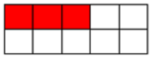
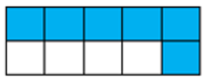
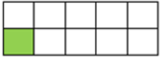
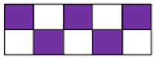
Practice
Complete the table with the correct form of the shaded squares.
Fraction | Decimal | Percentage
 | 0.3
 |  | 60%
1/10
Notes:
Ask students to make sure they have reduced the fractions.

Slide 32
Answers
Fraction | Decimal | Percentage
3/10 | 0.3 | 30%
6/10 or 3/5 | 0.6 | 60%
1/10 | 0.1 | 10%
5/10 or 1/2 | 0.5 | 50%
Notes:
Ask students to make sure they have reduced the fractions.

Slide 33
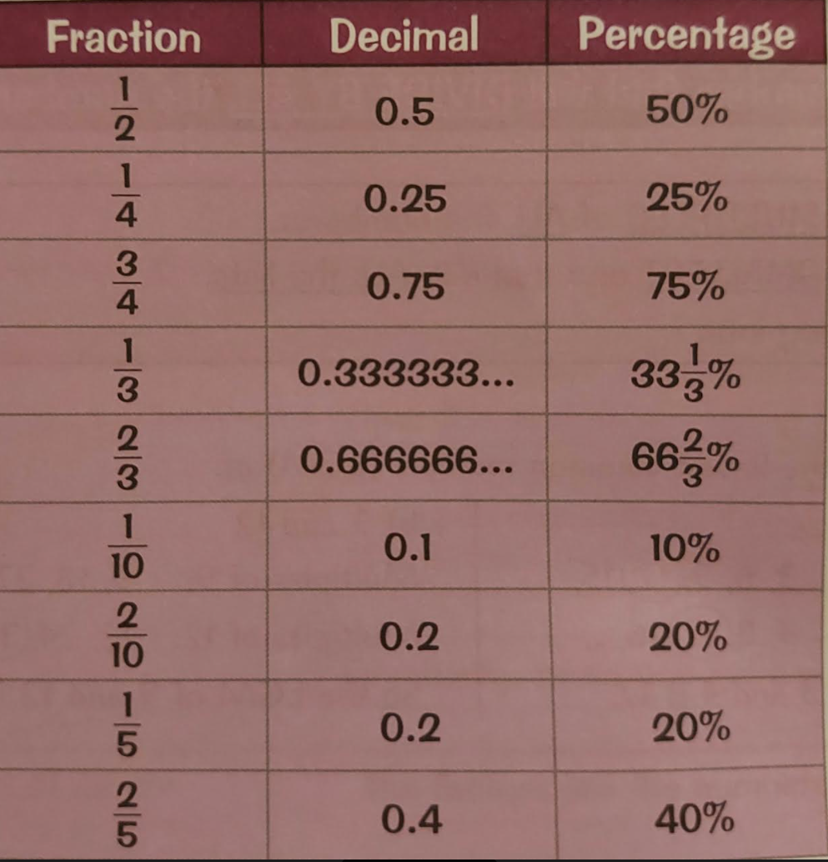
Summary of common equivalent forms
Notes:
Explain to students that it’s helpful to learn some of the most common equivalences.

Slide 34
Using percentages in the retail sector

Slide 35
What is the retail sector?
The retail sector includes any business or individual involved with selling products directly to consumers. The retail sector includes shops, department stores, supermarkets, market stalls, door-to-door sales people and internet retailers.
https://researchbriefings.files.parliament.uk/documents/SN06186/SN06186.pdf

Slide 36
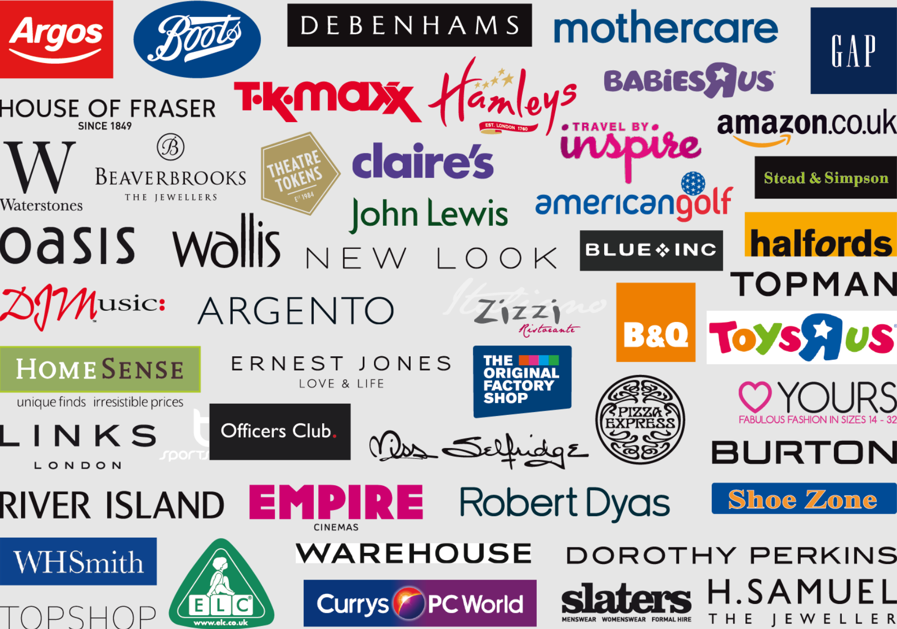
How many of these famous retailers do you know?

Slide 37
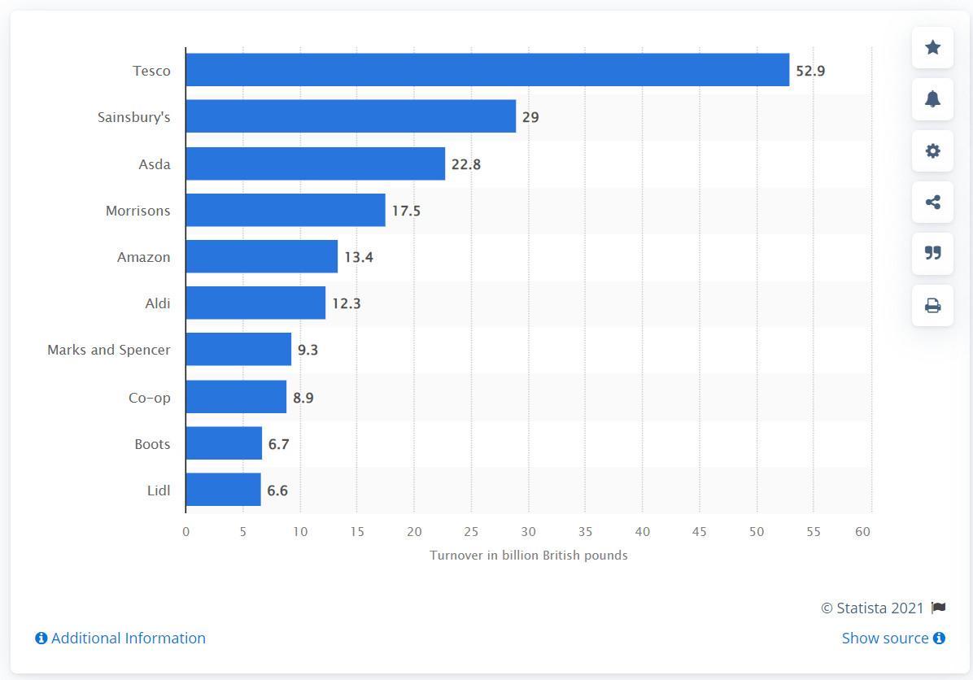
Based on ‘turnover’, can you guess which is the largest retailer in the UK?
Notes:
Explain what ‘turnover’ means.
This information is likely to have changed since it was sourced.

Slide 38
Key figures
Retail sector economic output was £97.0 billion in 2020,
5.0% of the UK’s total economic output and a 2.5% fall on 2019
There were 3.0 million jobs in the retail sector in 2019
There were 310,000 retail businesses as of 1 January 2020
For every pound spent in 2020:
41 pence was spent in food shops
9 pence was spent in clothing shops
8 pence was spent on automotive fuel
8 pence was spent in household goods shops (including electronics and furniture stores)
https://researchbriefings.files.parliament.uk/documents/SN06186/SN06186.pdf

Slide 39

A common formula
What do different retailers have in common?
Whether it’s shoes, diamonds or hamburgers, retailers need to make money on the goods they sell. The price at which a retail business purchases merchandise is known as the unit cost. The retailer then sells the product at a higher price. This is known as the selling price. The difference between the selling price and the unit cost is known as the markup. In order to compare the amount of markup between products, a markup rate is used.
markup rate = $\frac{markup value}{unit cost}$ x 100

Slide 40

Example
The unit cost of a two-litre bottle of coca cola from Sainsbury’s supermarket is £0.90p. It sells the coke to the customer for £1.60. The markup value is the selling price minus the unit cost. Therefore, the markup value would be £0.70p.
Markup rate = $\frac{0.7}{0.9}$ x 100
The markup rate on a bottle of coke sold at Sainsbury’s would therefore be 77.7%

Slide 41



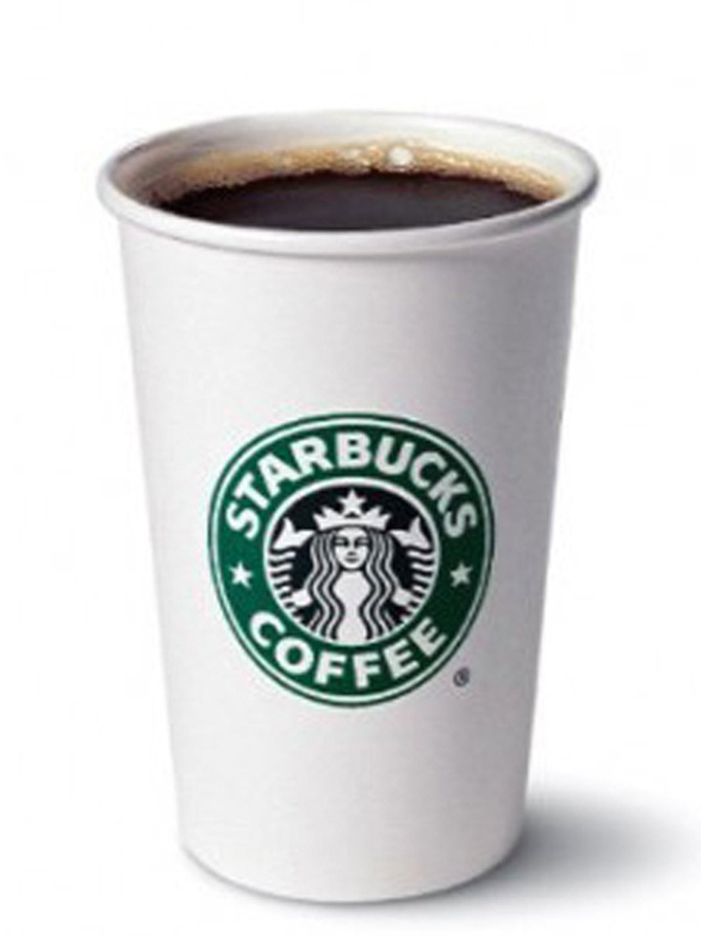
Guessing markup rate
Look at the following list of products. Put them in order of markup rate from highest to lowest
This Photo by Unknown Author is licensed under CC BY-SA

Slide 42
Answers
1.
Unit cost: $0.10
Selling price: $3.00
Markup rate: 2,900%
3.
Unit cost: $146
Selling price: $1,642
Markup rate: 1,025%
4.
Unit cost: $490
Selling price: $1,099
Markup rate: 124%
2.
Unit cost: $0.35
Selling price: $4.81
Markup rate: 1,274%
Why Companies Mark Up Their Products (Infographic) (ibrandstudio.com)
This Photo by Unknown Author is licensed under CC BY-SA
Notes:
Explain that these figures are just a general guide. Numbers will change from year to year, and from one retailer to the next.
You could hide the markup rate and get students to calculate it first, or show them how it was calculated after you’ve revealed the answers.

Slide 43
Why are some markup rates so high?
Consumer demand due to popular brands e.g. iPhone
Oligopoly on certain products driving up prices, e.g. diamonds
Convenience of product due to location e.g. Starbucks in a train station or popcorn in a cinema
Companies need to recoup costs of research and development e.g. iPhone
Why Companies Mark Up Their Products (Infographic) (ibrandstudio.com)
Notes:
These are just some of the reasons.
Explain ‘oligopoly’.

Slide 44
Homework

Slide 45
Homework
Week 4 quiz
Kortext page 390 question 1 (case study no.1)
Notes:
Students should be doing the weekly quiz as an absolute minimum. Please monitor completion rates.
The case study question is interesting because although the calculation is straightforward, the amount of additional information may be confusing for some students. This is good practice in cutting through irrelevant information and focusing only on that which is necessary for the calculation.

Slide 46
End of Week 4
Any questions?

